Slide 1
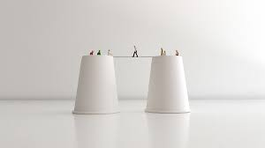

CONFIDENCE BUILDING
GROUP MEMBERS
AMNA NAEEM
MUNEEBA SOHAIL
ROMEESA KHALID
SABEELA ALI
WAJIHA ISMAIL

Slide 2


SELF-CONFIDENT
Self-confidence is trusting in your own abilities, capacities and judgment.

Slide 3

VISUALIZE YOURSELF
“What the mind can conceive and believe it can achieve.” -- Napoleon Hill

Slide 4


TAKE RISKS ONCE YOU'VE GAINED ENOUGH SELF CONFIDENCE
Skill foundation
Don’t stop there, stretch yourself by practical challenges
Boost your newfound self-confidence

Slide 5

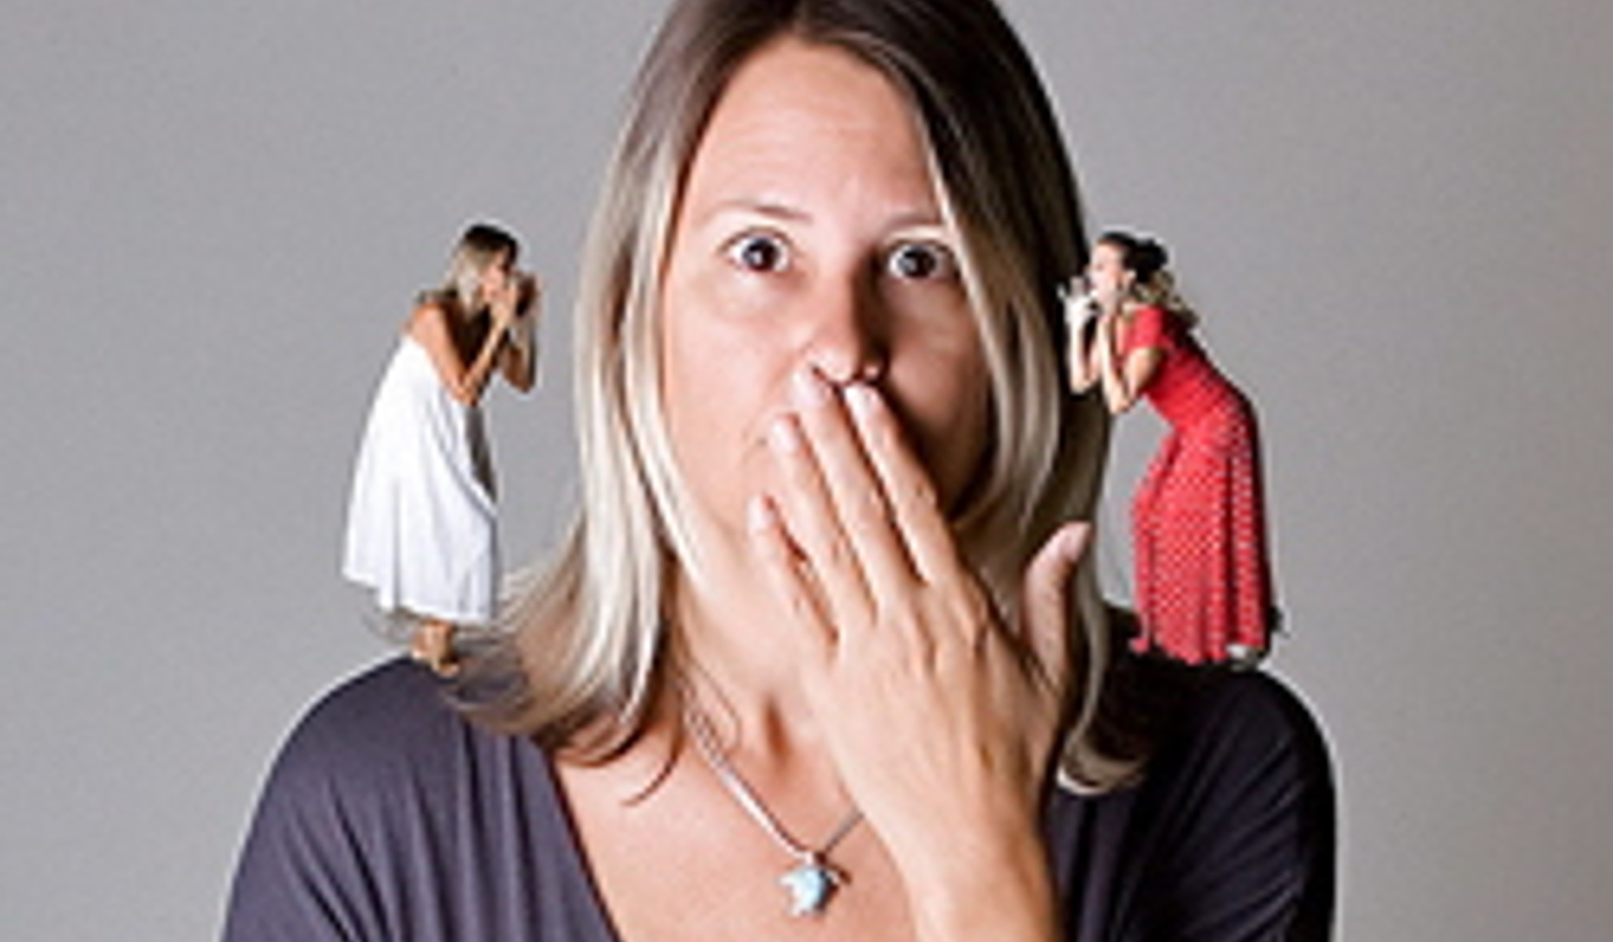
QUESTION YOUR INNER CRITIC
“You have been criticizing yourself for years, and it hasn’t worked. Try approving of yourself and see what happens.” -- Louise L. Hay

Slide 6

SET YOURSELF UP TO WIN
Set goals
Built a stream of successes
Achievements
“To establish true self-confidence, we must concentrate on our successes and forget about the failures and the negatives in our lives.” -- Denis Waitley

Slide 7
HELP SOMEONE ELSE
Instead of focusing on your own weaknesses
volunteer to mentor
assist or teach

Slide 8
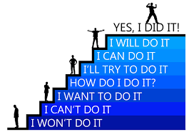
CREATE PERSONAL BOUNDARIES
“Never be bullied into silence. Never allow yourself to be made a victim. Accept no one’s definition of your life, but define yourself.”-- Harvey Fierstein

Slide 9
CARE FOR YOURSELF
good physical health
emotional health
feel good about yourself
“Self-care is never a selfish act -- it is simply good stewardship of the only gift I have, the gift I was put on earth to offer to others.” -- Parker Palmer

Slide 10

TAKE THE 100 DAYS OF REJECTION CHALLENGE
Busting fear.
You want to have fun while building up your self-confidence.
“No one can make you feel inferior without your consent.” -- Eleanor Roosevelt

Slide 11

STOP COMPARING STAY FOCUSED ON YOU
Every body should not compare with one another
Every one has their own strengths and weakness
When you accept everything you will succeed

Slide 12
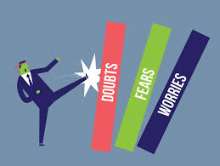

BE FEARLESS
If you set big goals and have big dreams you’re going to feel over whelmed and you are not going to feel like. You can’t do it
You have to look inside yourself and gather every, once courage you have
Think about hoe much you want to achieve your goal and put your fear aside and keep going

Slide 13

STAND UP FOR YOUR SELF
Someone says that your goal is stupid ,that you can not do it because of doubts inside your head
Tell people that you believe in your goal and you are going to accomplish it.
Don’t let anyone ,ever make you feel like you don’t deserve what you want.

Slide 14
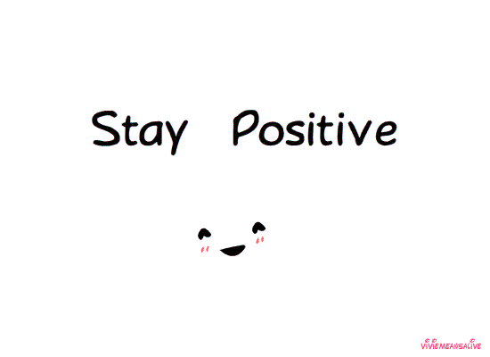
ACT POSITIVE
Improve your personality and build confidence by acting positive.
Action is the key of developing self-confidence.
When you start acting positive you can feel good changes in yourself.

Slide 15

GET PREPARED
When you are prepared you feel confident.
You feel confident in your abilities when you prepare yourself.
Preparation is the key to success.

Slide 16


BE GRATEFUL
Be thankful if you want to be happy and build a strong inner confidence.
It help you to remove negative thoughts from your mind.
Gratitude can turn negative in to positive.

Slide 17


DRESS UP WELL
When you dress up well you feel confident.
Good looks no doubt will add to your personality.
It plays a major role in personality development.

Slide 18

SMILE
A SMILE IS THE
LIGHT ON YOUR
FACE THAT LETS
SOMEONE KOW
YOU’RE HOME.

Slide 19

THE
GOOD NEWS
GIRL

Slide 20

A JOURNEY OF A THOUSAND MILES
BEGINS WITH A SINGLE STEP.
CHINESE PROVERB
DREAMS

Slide 21

ITS
NEVER
TOO LATE

Slide 22
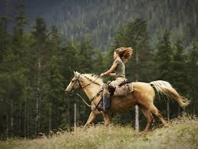
Imperfect action is better than perfect inaction.
Harry Truman
Do It Now

Slide 23

It’s A Funny Thing About Life;
If You Refuse To Accept
Anything But The Best,
You Very Often Get It.
W. Somerset Maughn
EXPECT THE BEST

Slide 24
Understand this
Life- changing law

Slide 25

FAITH
Beautiful Light Is Born Of Darkness,
So The Faith That Springs From Conflict
Is Often The Strongest And Best
R. Turnbull

Slide 26

KEEP THE FAITH

Slide 27
FIND OUT HOW CONFIDENT YOU APPEAR TO OTHERS
Three ways to find out that what others think about you, are you confident or not?
"What are three adjectives you would use to describe me?"
Are these adjectives consistent with how you see yourself?
Go through previous recommendations, performance reviews and comments you received

Slide 28

Compare your actions in the table below:
CONFIDENT BEHAVIOR | LOW SELF-CONFIDENCE
Doing what you feel is right even if others criticize you | Acting based on what you think will win your peers and manager’s approval
The ability to take calculated risks | Staying in your comfort zone for fear of failure and rejection
Knowing how to accept compliments graciously | Ignoring compliments
Owning up to your mistakes | Passing blame, or covering it up until you can fix them

Slide 29




